Slide 1
Mid-term Project
Team Apple
Jian Wang
Yulong Luo
Qi Zhu

Slide 2
INTRODUCTION
Apple Inc., is an American corporation that designs, develops, and sells consumer electronics, computer software and personal computers.
Its best-known hardware products are the Mac line of computers, the iPod, iPhone, and iPad. Its software includes the OS X and iOS operating systems.
In our project, we compared three Smartphone including iPhone (Apple), Galaxy (Samsung), and Lumia (Nokia), as well as three operating systems including iOS, Android, and Windowsphone.

Slide 3
DATA SOURCE
Data collected from Twitter API
Two ways to collect data:
Collect tweets with keywords: in order to analysis the detail aspect of the products such as quality, out-looking, speed, etc.
Collect tweets without keywords: in order to find out the popularity of the products. Basic idea is to gather tweets that posted in a certain period of time.
Total tweets collected:
Smartphone: 289,743 (iPhone:239,328, Galaxy:46,361, Lumia:4,054)
Operating system: 421,443 (iOS: 40,280, Android: 379,752, Windowsphone: 1,411)
Collected without keywords: 311,774

Slide 4
KEY WORDS
Positive words
Negative words
Mobile phone:
fast
elegant
beautiful
comfortable
friendly
easy
small
quick
colorful
clean
shapely
pretty
good-looking
thin
light
sensitive
Width
Operating system:
fast
friendly
safe
easy
quick
compatible
flexible
fluency
good design
creative
openness
free
Mobile phone:
defective
overpriced
expensive
fragile
ugly
slow
poor
large
weak
heavy
insensitive
bad-looking
Thick
Operating system:
difficult
slow
poor
unsafe
expensive
overpriced
hard
high capacity

Slide 5
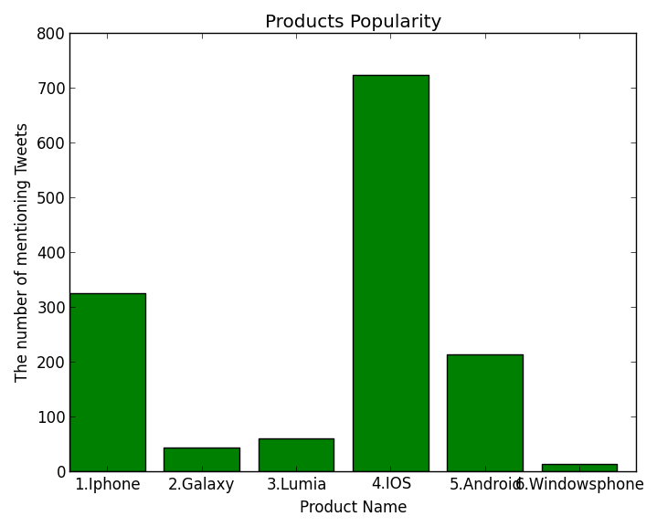
ANALYSIS AND RESULTS
General analysis (without keywords)
iPhone | Galaxy | Lumia | iOS | Android | Windowsphone | Total tweets
325 | 43 | 60 | 723 | 213 | 13 | 311,774
iPhone Smartphone and IOS operating system are most popular products that people chose.
Lumia is brand new mobile phone, Less people talk about Windowsphone system.

Slide 6
ANALYSIS AND RESULTS
General analysis (with keywords)
Product | Positive | Negative | Ratio | Tweets_Count
iPhone | 12,916 | 955 | 93.12% | 239,328
Galaxy | 338 | 21 | 94.15% | 46,361
Lumia | 123 | 9 | 93.18% | 4,054
Systems | Positive | Negative | Ratio | Tweets_Count
iOS | 1,747 | 101 | 94.53% | 40,280
Android | 5,713 | 435 | 92.92% | 379,752
Windowsphone | 50 | 10 | 83.33% | 1,411

Slide 7
ANALYSIS AND RESULTS
iPhone is highly mentioned but the positive ratio is lowest among those three mobile phones.
iPhone has the largest user-base, however, the users of Galaxy have the greatest satisfaction of the product.
Android smartphones are more widely used than iOS and windows OS.
The iOS has the highest positive ratio and windows OS has the lowest positive ratio.
Android system has the largest user-base and the iOS customers are more satisfied than Android’s.

Slide 8
ANALYSIS AND RESULTS
Mobile phone analysis: Positive words
 | Pos_words | iPhone | Ratio | Galaxy | Ratio | Lumia | Ratio
Speed | quick | 263 | 2.04% | 11 | 3.25% | 1 | 0.81%
 | fast | 694 | 5.37% | 86 | 25.44% | 18 | 14.63%
Looking | elegant | 49 | 0.38% | 3 | 0.89% | 1 | 0.81%
 | pretty | 469 | 3.63% | 13 | 3.85% | 2 | 1.63%
 | good-looking | 1 | 0.01% | 0 | 0 | 0 | 0
 | beautiful | 2,475 | 19.16% | 9 | 2.66 % | 4 | 3.25%
 | shapely | 0 | 0 | 0 | 0 | 0 | 0
 | comfortable | 28 | 0.22% | 1 | 0.30% | 0 | 0
 | friendly | 31 | 0.24% | 0 | 0 | 0 | 0
 | sensitive | 13 | 0.10% | 0 | 0 | 1 | 0.81%
 | easy | 186 | 1.44% | 5 | 1.48% | 5 | 4.07%
Qualities | small | 226 | 1.75% | 7 | 2.07% | 1 | 0.81%
 | colorful | 10 | 0.08% | 0 | 0 | 5 | 4.07%
 | thin | 7,282 | 56.38% | 177 | 52.37% | 70 | 56.91%
 | light | 1,186 | 9.18% | 25 | 7.04% | 15 | 12.20%
 | width | 3 | 0.02% | 1 | 0.30% | 0 | 0
 | Total | 12,916 |  | 338 |  | 123

Slide 9
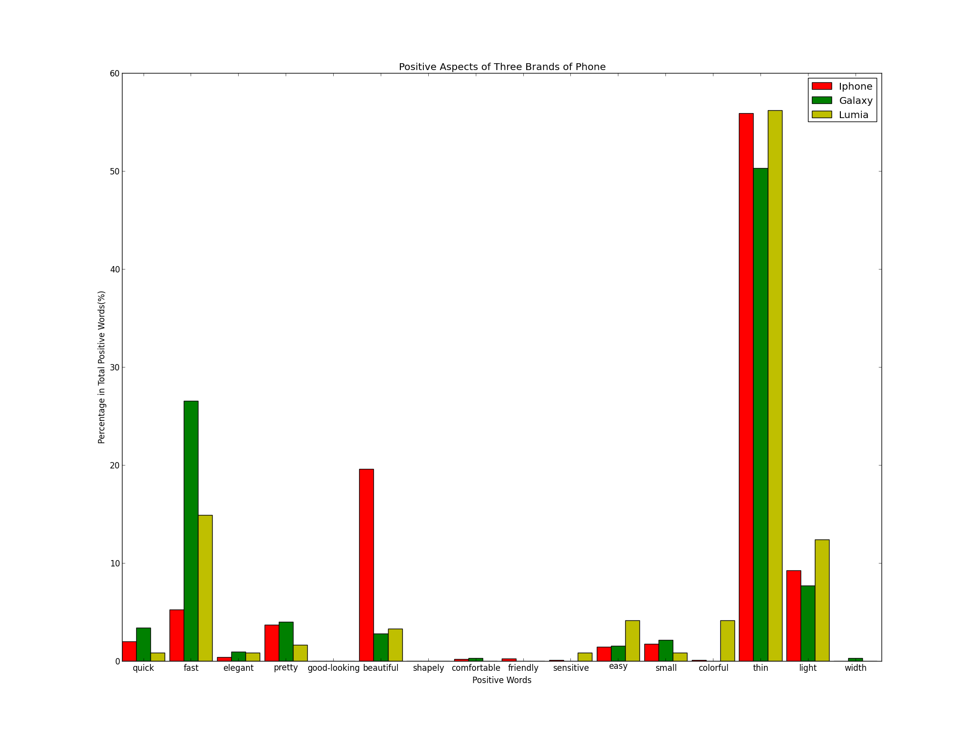
ANALYSIS AND RESULTS
Positive words for Mobile Phone

Slide 10
ANALYSIS AND RESULTS
Mobile phone analysis: Negative words
 | Neg_words | iPhone | Ratio | Galaxy | Ratio | Lumia | Ratio
 | defective | 10 | 1.05% | 0 | 0 | 0 | 0
price | overpriced | 7 | 0.73% | 2 | 9.52% | 0 | 0
 | expensive | 68 | 7.12% | 1 | 4.76% | 3 | 33.33%
 | ugly | 98 | 10.26% | 6 | 28.57% | 0 | 0
 | fragile | 10 | 1.05% | 0 | 0 | 1 | 11.11%
 | slow | 259 | 27.12% | 4 | 19.05% | 0 | 0
 | poor | 163 | 17.07% | 2 | 9.52% | 2 | 22.22%
 | weak | 244 | 25.55% | 2 | 9.52% | 0 | 0
 | large | 60 | 6.28% | 4 | 19.05% | 0 | 0
 | heavy | 32 | 3.35% | 0 | 0 | 3 | 33.33%
 | insensitive | 4 | 0.42% | 0 | 0 | 0 | 0
 | bad-looking | 0 | 0 | 0 | 0 | 0 | 0
 | Total | 955 |  | 21 |  | 9

Slide 11
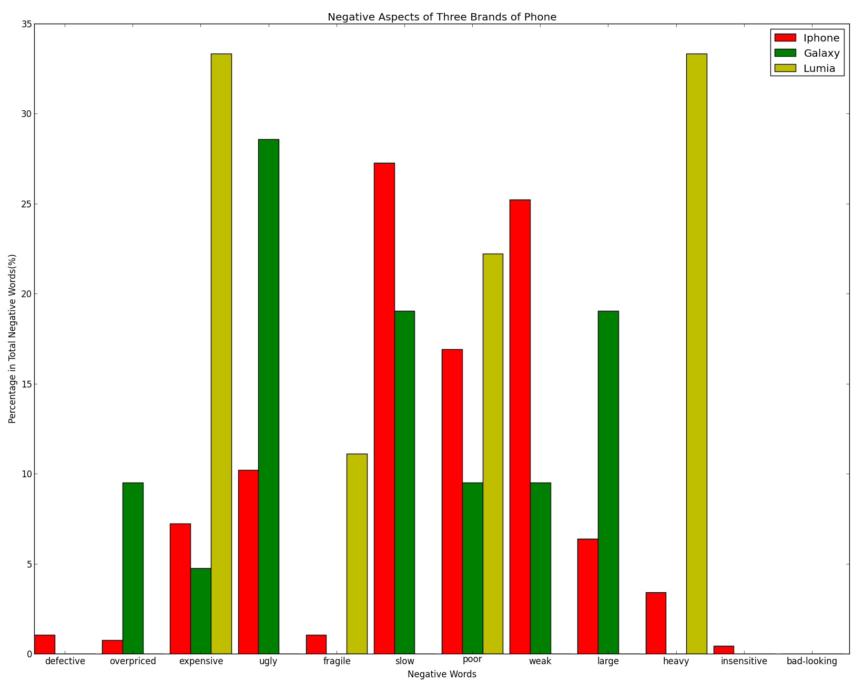
ANALYSIS AND RESULTS
Negative words for Mobile Phone

Slide 12
ANALYSIS AND RESULTS
Speed. Galaxy is running faster than iPhone and Lumia.
Appearance. People would consider iphone is much more beautiful then Galaxy and Lumia.
Big proportion of customers thinks that those three brands of mobile phones are thin and light.
Lumia’s price is the most expensive mobile phone.
iPhone’s operation is slower than Galaxy.
The weight of Lumia is much heavier than iPhone and Galaxy.
Galaxy seems have large screen than iPhone.
Over all, iphone is the best-looking compared to the other two mobile phones.

Slide 13
ANALYSIS AND RESULTS
Operating system analysis: Positive words
Pos_words | iOS | Ratio | Android | Ratio | Windowsphone | Ratio
smart | 475 | 27.19% | 2013 | 35.24% | 25 | 50.00%
fast | 591 | 33.83% | 333 | 5.84% | 5 | 10.00%
quick | 40 | 2.29% | 69 | 1.21% | 2 | 4.00%
friendly | 19 | 1.09% | 24 | 0.42% | 0 | 0
compatible | 54 | 3.09% | 21 | 0.37% | 1 | 2.00%
flexible | 0 | 0 | 8 | 0.14% | 1 | 2.00%
fluency | 0 | 0 | 2 | 0.04% | 0 | 0
safe | 21 | 1.20% | 108 | 1.89% | 1 | 2.00%
easy | 21 | 1.20% | 159 | 2.78% | 1 | 2.00%
good design | 0 | 0 | 0 | 0 | 0 | 0
creative | 26 | 1.49% | 9 | 0.16% | 0 | 0
openness | 0 | 0 | 0 | 0 | 0 | 0
free | 500 | 28.62% | 2,967 | 52.93% | 14 | 28.00%
Total | 1,747 |  | 5,713 |  | 50

Slide 14
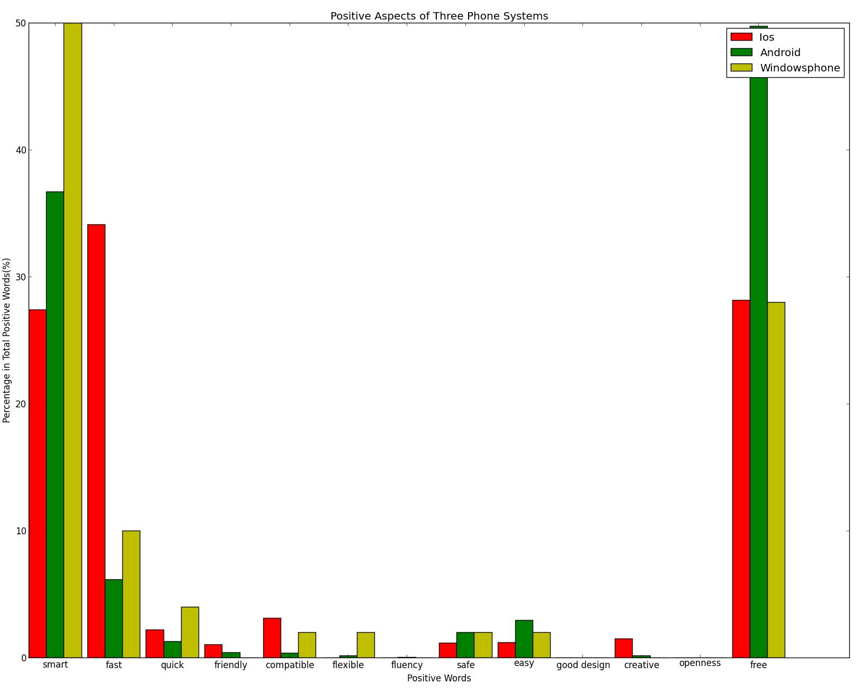
ANALYSIS AND RESULTS
Positive words for Operating System

Slide 15
ANALYSIS AND RESULTS
Operating system analysis: Negative words
Neg_words | iOS | Ratio | Android | Ratio | Windowsphone | Ratio
difficult | 3 | 2.97% | 127 | 29.20% | 1 | 10.00%
slow | 25 | 24.75% | 41 | 9.43% | 1 | 10.00%
poor | 14 | 13.86% | 34 | 7.82% | 4 | 40.00%
unsafe | 1 | 0.99% | 0 | 0 | 0 | 0
expensive | 11 | 10.89% | 14 | 3.22% | 0 | 0
overpriced | 2 | 1.98% | 1 | 0.23% | 0 | 0
hard | 45 | 44.55% | 218 | 50.11% | 4 | 40.00%
Total | 101 |  | 435 |  | 10

Slide 16
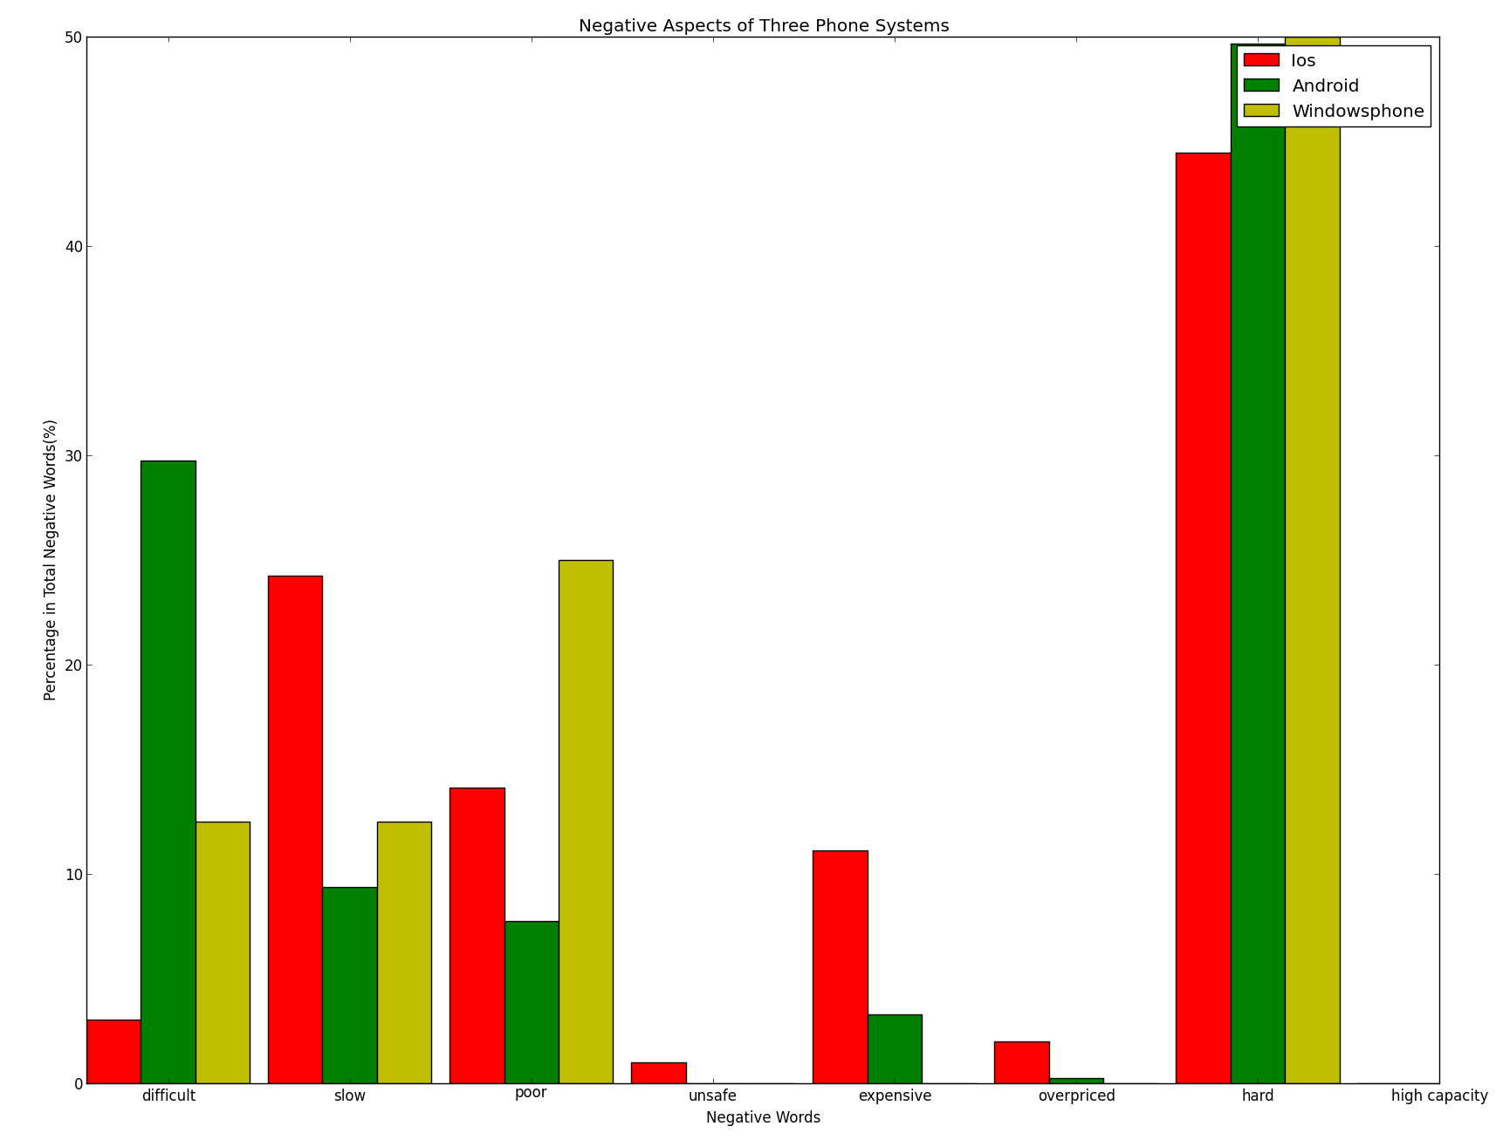
ANALYSIS AND RESULTS
Negative words for Operating System

Slide 17
ANALYSIS AND RESULTS
Three main aspects are focused on smart, speed, and free app characters. iOS operating system have highest speed, while opposite to Android and Windows phone. Mobile phones with same configuration, iPhone is running faster than Android phone and windows phone.
Android does the best in free app aspect compared to the other two systems. Because Android is an open source system, it is easy for companies to develop on that platform.
Turning to Windows phone, its smart feature is mentioned most. So the three systems have their own advantages.
iOS has the strongest quality in all these three aspects.

Slide 18
RECOMMENDATION
Apple should improve the performance of iPhone’s hardware devices.
Apple should keep its products’ advantages, such as good appearance, size and weight.
Apple should keep and improve operating system iOS’ fast speed in order to make up the lower performance of hardware.
More free apps should be provided in Apple store.
Improve the usability of iOS for people to develop apps.

Slide 19
Thanks!
ANALYSIS AND RESULTS

